Slide 1





Project Child HANDS
Child Care, Subsidy and Early Education: Helping Analyze Needed Data Securely
Isabel S. Bradburn
Aaron D. Schroeder
Virginia Department of
Education
VLDS INSIGHTS Conference
Fairfax, Virginia June 25, 2013

Slide 2
Project Child HANDS
Review purpose and development
Present an overview of its technology
Present preliminary research results
Discuss current status, next steps
Insights gained so far
Integration with VLDS
Examples of policy and program questions
Notes:
WHAT IS IT?
INITIAL, because we anticipate the scope expanding beyond only child care subsidy and early childhood education, and we have built it for this eventuality.
However, subtitle sums it up: This is a very secure system to analyze data across agencies and databases that is NEEDED, USEFUL and MEANINGFUL.
--It is a FEDERATED system, meaning, no need for a data warehouse; queries or analyses are “matched” across databases virtually in real time.
Critically, the system shares data across agencies, so that we can really look at what happens with children and families over time and through different public programs.

Slide 3
Project Child HANDS: What is it?
A system for cross-agency linking of early childhood data for policy analysis and program evaluation
Uses primarily administrative data
Child-level, family-level and program-level linkage
Notes:
WHAT IS IT?
INITIAL, because we anticipate the scope expanding beyond only child care subsidy and early childhood education, and we have built it for this eventuality.
However, subtitle sums it up: This is a very secure system to analyze data across agencies and databases that is NEEDED, USEFUL and MEANINGFUL.
--It is a FEDERATED system, meaning, no need for a data warehouse; queries or analyses are “matched” across databases virtually in real time.
Critically, the system shares data across agencies, so that we can really look at what happens with children and families over time and through different public programs.

Slide 4
Project Child HANDS
GOAL:
Put all the pieces
together to
answer
important
questions
Notes:
To reiterate, this system is designed as an evaluation and policy tool, NOT a case management, customer portal, or accountability system.

Slide 5
What are Administrative Data?
Administrative records
Program eligibility, participation, demographics (client-level)
Payment records, provider information, quality data (program-level)
Birth records (child- and family-level)
School records (mostly child-level)
Demographics
Enrollment, attendance
Special education status
Screeners and Standard of Learning test scores

Slide 6
Project Child HANDS
Is compliant with Federal and State Privacy Laws
Uses a federated architecture
Does not require new “data center” establishment (low cost)
Can be easily expanded to include additional data partners
Uses compatible technologies with other state data initiatives (e.g. VA Longitudinal Data System)

Slide 7
Where did it come from?
U.S. Department of Health and Human Services, Administration for Children and Families, Office of Planning, Research and Evaluation (Cooperative Agreement HHS-#90YE0106)
Three years + no cost extension (Oct 1, 2008 – Sept 30, 2012)
State-University partnership grants
Purpose to improve state data capacity for child care subsidy and related early childhood programs
Virginia 1 of 4 states (with Maryland, Maine, South Carolina)

Slide 8
Project Child HANDS
Initial Partners
Virginia Department of Social Services, Child Care + Early Childhood Development (Lead Agency)
Virginia Department of Education, Research and Strategic Planning
Child Development Center for Learning and Research & the Institute for Policy and Governance, Virginia Tech

Slide 9
Project Child HANDS
Child Care Assistance (Subsidy) Program
Federal Work support program
Administered through states (Block grants)
Eligibility based on work, training and income status
Lose work, lose child care assistance
Birth through age 12
Increasing emphasis also on children’s development

Slide 10
Project Child HANDS in Action
Initial Research Study
Initial Questions To Drive Development
What type of care are parents choosing with subsidy dollars?
What is the quality of the child care?
How are their children doing in Kindergarten?
Notes:
The design and development start-up, then, focused on research questions of particular interest to policy makers and administrators of the child care subsidy program, a work support programs for parents. WE are now phasing into more broad applicability, while continuing to examine the subsidy program as more data from the new child care automation and case management system comes on line.

Slide 11
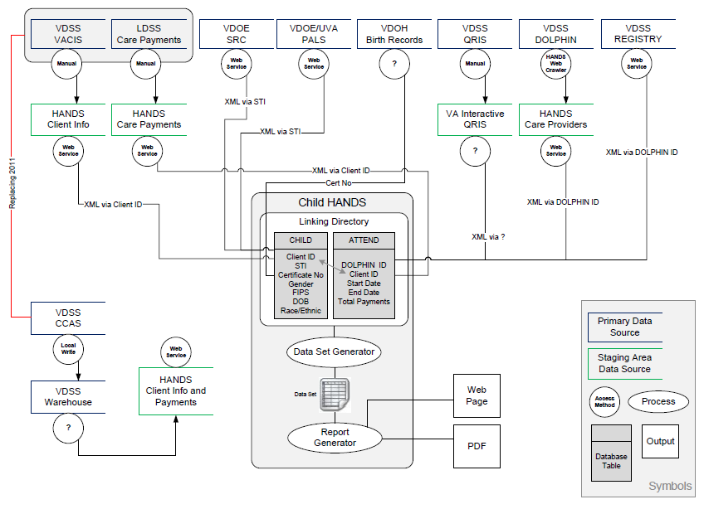
Initial Data Systems for Integration
Data Sources

Slide 12
What is a Federated Data System?
Dataset 1
Dataset 2
Integrating Apparatus
Query
User
Merged Data Set
Dataset 3

Slide 13




HANDS Federated Process – Data Sets are not Retained
Agency 1 Dataset
Agency 2 Dataset
Agency 3 Dataset
Sub-queries get data from datasets
User fills out web form to specify query
SELECT * FROM … JOIN ON … VDSS.TABLE1.COLUMN1, VDOE.TABLE1.COLUMN1
System uses Linking Directory to create query
THE DATASET IS THEN PURGED FROM MEMORY – NOTHING IS STORED
Linking Directory
User is returned an aggregated report or dataset, depending on level of authorization

Slide 14
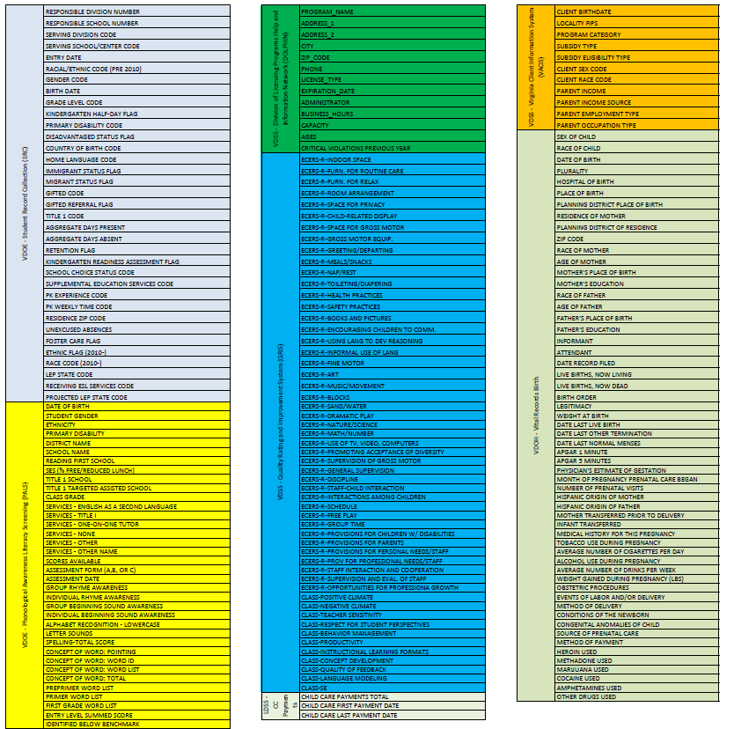
What does the system create?
A Multi-Agency Data Set of De-Identified
Virtual Child Records
Or Program Records
SAMPLE – NOT ACTUAL

Slide 15
How Does De-Identification Work in the HANDS System?
The Data Adapters prepare the data (including de-identification) before leaving the agency firewall.
Agency 1 Data Source
Agency 2 Data Source
HANDS
DATA ADAPTER
DATA
ADAPTER
Agency Firewalls

Slide 16
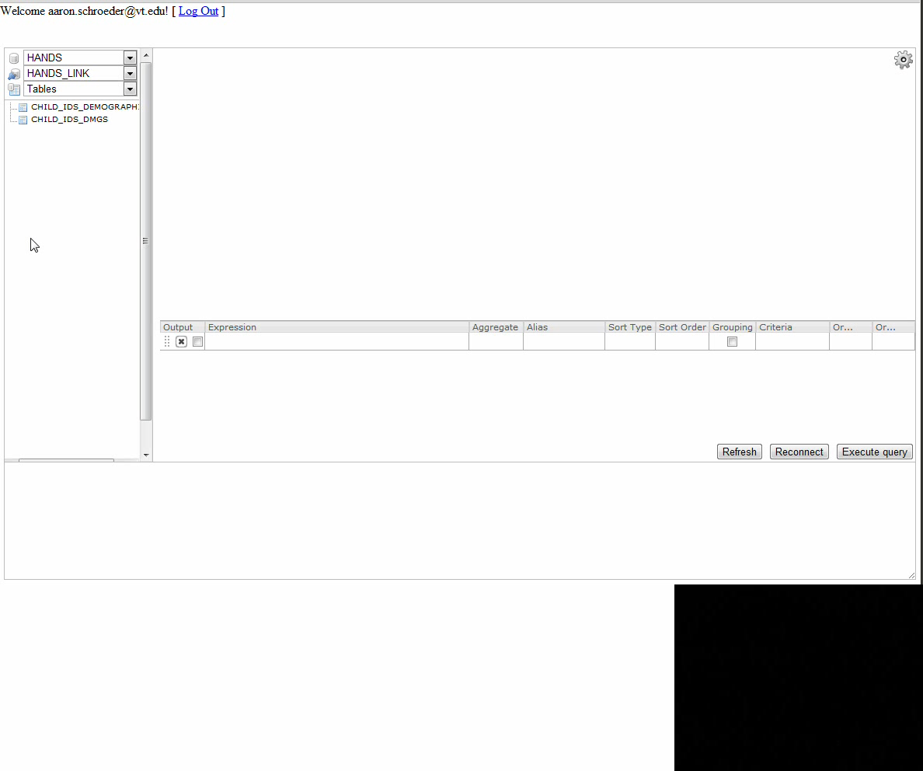
What do we get after creating the Linking Directory? HANDS Linking in Action!
Data being linked and pulled from multiple agency Data Adapters.
This used to take MUCH LONGER.

Slide 17
Initial Research Study
Five Localities (Wave I)
Time period: 2006 – 2010
Sample
From five localities, subsidy children = 6009
Youngest were infants (n = 1230); Oldest 16 by end of study period (n = 26)
1862 with birth date between '9/30/2001' and '9/30/2004‘

Slide 18
Initial Research Study
Subsidy to Licensing Match
888 vendors received subsidy payments during study time period
452 matched to licensing data (51% )
This match accounts for 72 % of the total Wave I children receiving subsidy during that time

Slide 19
Initial Research Study
Research Q 1: What type of care were parents choosing for their children with subsidy dollars?
Substantially more parents (72.5%) enrolled their children in licensed child care compared to FFN (27.5%)
Equally child care centers (44 %) and family child care homes (44%), with 11% in religiously-exempt placements.
Notes:
Most families in the sample chose licensed care – almost three-quarters, in fact. Of licensed or regulated placements, families were equally likely to choose center or family child care, with 11 percent sending their children to a religiously-exempt placement.

Slide 20
Initial Research Study
Subsidy Use Patterns
The more subsidy spells, the more likely a child enrolled in multiple programs.
Children with more subsidy spells were slightly more likely to have longer spells.
The most common pattern: a single spell of about 9 months in the same program
Notes:
Definition of “spell” – continuous subsidy payment to a provider or providers with no more than one month break between payments. Note that as of yet, we don’t know what KIND of program the child was in – could be full, partial day or wrap-around services.

Slide 21
Initial Research Study
Using a cohort model (child N=3182)
61% received subsidy childcare from a single caretaker
26% had two different caretakers.
Approximately 5% had four or more different caretakers
What we can’t know from this analysis is whether these differences
primarily reflect multiple simultaneous caregiving arrangements,
or sequential changes.

Slide 22
Initial Research Study
Q2: What is the quality of care?
Quality Type | Quality Indicator | Data Source
Licensed or not | VA Child care license | VDSS DOLPHIN
License violations | Number and type of licensing violations | VDSS Risk Assessment Matrix
Center Environment | Classroom Observations | VSQI (VDSS and Virginia Interactive)
Staff Qualifications | Transcripts, professional Development records | Early Childhood Professional Registry (in development)

Slide 23
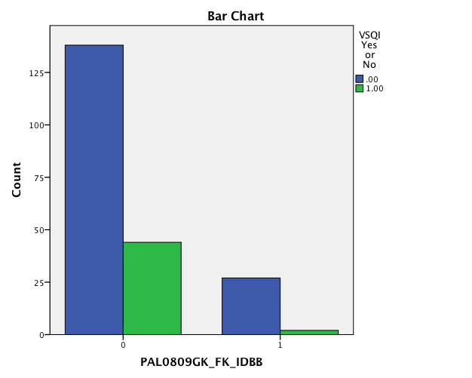
Child Care QI and Child Outcomes
Are children who attended a VSQI center prior to K more likely to meet kindergarten fall PALS benchmarks?
Preliminarily, YES
VSQI prior to K
Green = Yes
Blue = No
94 % VSQI attendees met fall PALS-K benchmark
83% others met benchmark
(chi-sq (N=211) = 5.404, p = .05, Fisher’s exact test, 2-sided).
Blue = No VSQI
Green = VSQI
MET DID NOT MEET
PALS-K FALL BENCHMARK
Based on all available records of children who attended care through subsidy program between Nov07-Aug 08 (6 localities, child N = 211), and attended kindergarten in fall 2008.

Slide 24
Initial Research Study
Subsidy to Kindergarten Match
8/1/2006 - 7/31/2010
Kindergarten in academic years 2006-07, 2007-08, 2008-09, and 2009-10
1862 with birth date between '9/30/2001' and '9/30/2004‘
1703 successfully matched to school records (91 %)

Slide 25
Initial Research Study
Q3: How did children
who used subsidy fare in Kindergarten?
Children who had longer continuous spells of subsidized care attended more days of public elementary school
Children who had longer care spells scored higher on fall Kindergarten PALS screener
Accounting for greater attendance, this group of children was more likely to meet fall Kindergarten PALS benchmarks.

Slide 26
Initial Research Study
Preliminary “INSIGHTS”
Project Child HANDS matching algorithms are capturing a very high percentage of eligible matches; supports use of the system.
Preliminary results examining child care subsidy patterns indicate longer continuous spells of care predicts better school readiness in domains we can measure.
If findings are replicated and robust, policy implications may be to allow longer care spells, more independent of parental employment.
Notes:
The latter point in one our federal funder is particularly interested in. The subsidy program was designed as a work support program, and studies show it is largely successful in this regard; however, we know less about possible benefits for children, and indeed, some studies show no benefit – which is not really surprising, considering that the quality and consistency of care varies enormously. If replicated, these preliminary results have the potential to contribute to the national policy conversation regarding this important family support during young children’s most critical brain development period.

Slide 27
Examples of Other Policy or
Evaluation Questions
What are the social service trajectories and
school outcomes of children born with special health care needs? (Hearing loss, birth defects)
What impact does early intervention have on school outcomes?
What interventions or programs are most helpful to children and families involved in child protective services?
Notes:
Our ECAC Data Integration Task Force committee on Policy Research is busily defining key areas for policy and program evaluation research, which we will present to the ECAC for comments, refining them iteratively before presenting them as recommendations next spring. Here are some examples of questions from our committee that Project Child HANDS could address with additional partners.

Slide 28
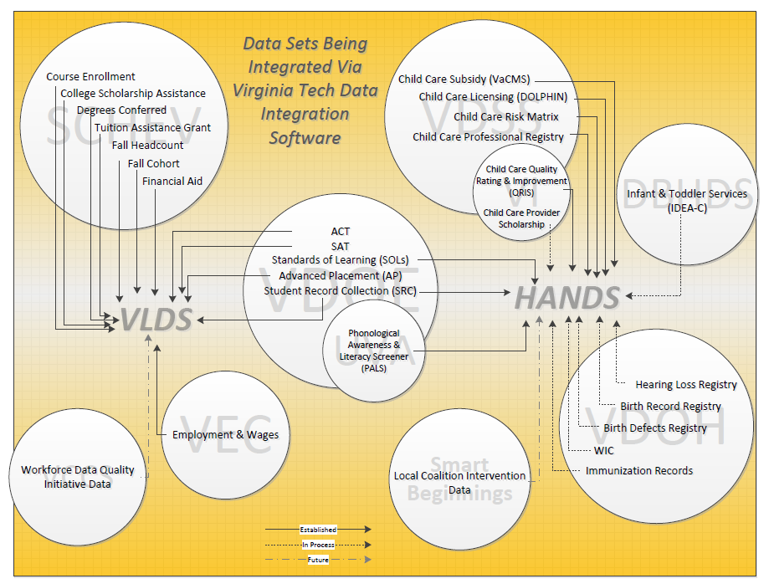
Child HANDS and the Virginia Longitudinal Data System

Slide 29
Current VLDS Integration Design

Slide 30
Current Status
Governor’s Early Childhood Advisory Council
Data Integration Task Force
Recommendations for use and expansion
Data governance
Research agenda
State-University collaborative research network
Funding options – varied portfolio
Developing reporting functions for participating agencies – e.g., 801 reports for child care assistance program, Head Start (?)

Slide 31

In Process: Adding New Partners
Virginia Department of Health, Family Health Services
Virginia Department of Behavioral Health and Developmental Services, Early Intervention
Virginia Early Childhood Foundation
VLDS partners: SCHEV, Virginia Employment Commission

Slide 32
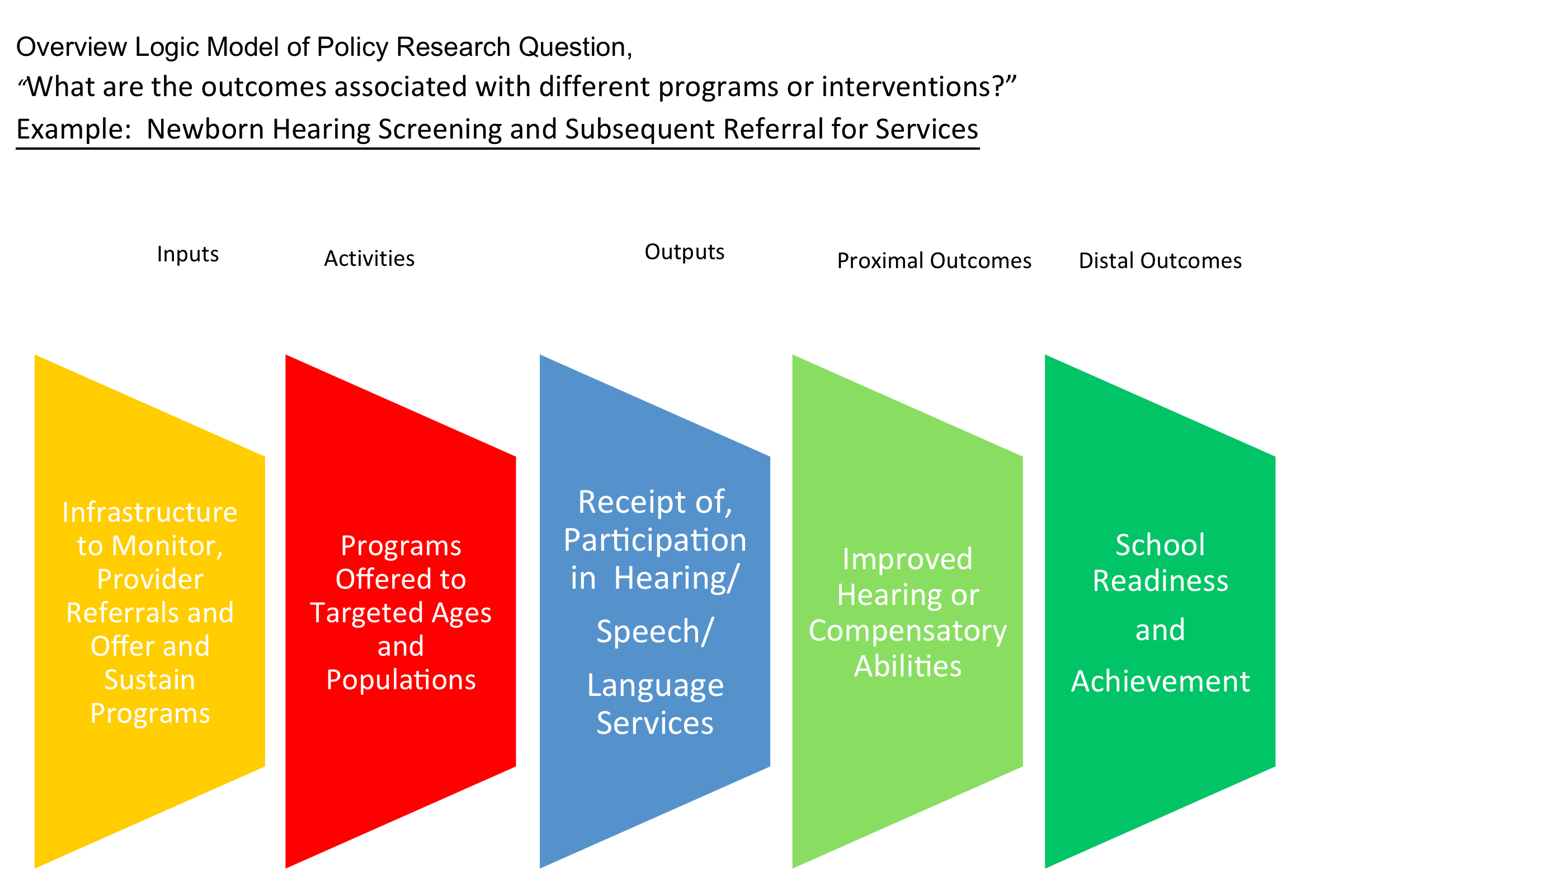
Example of Research that Child HANDS can Facilitate

Slide 33
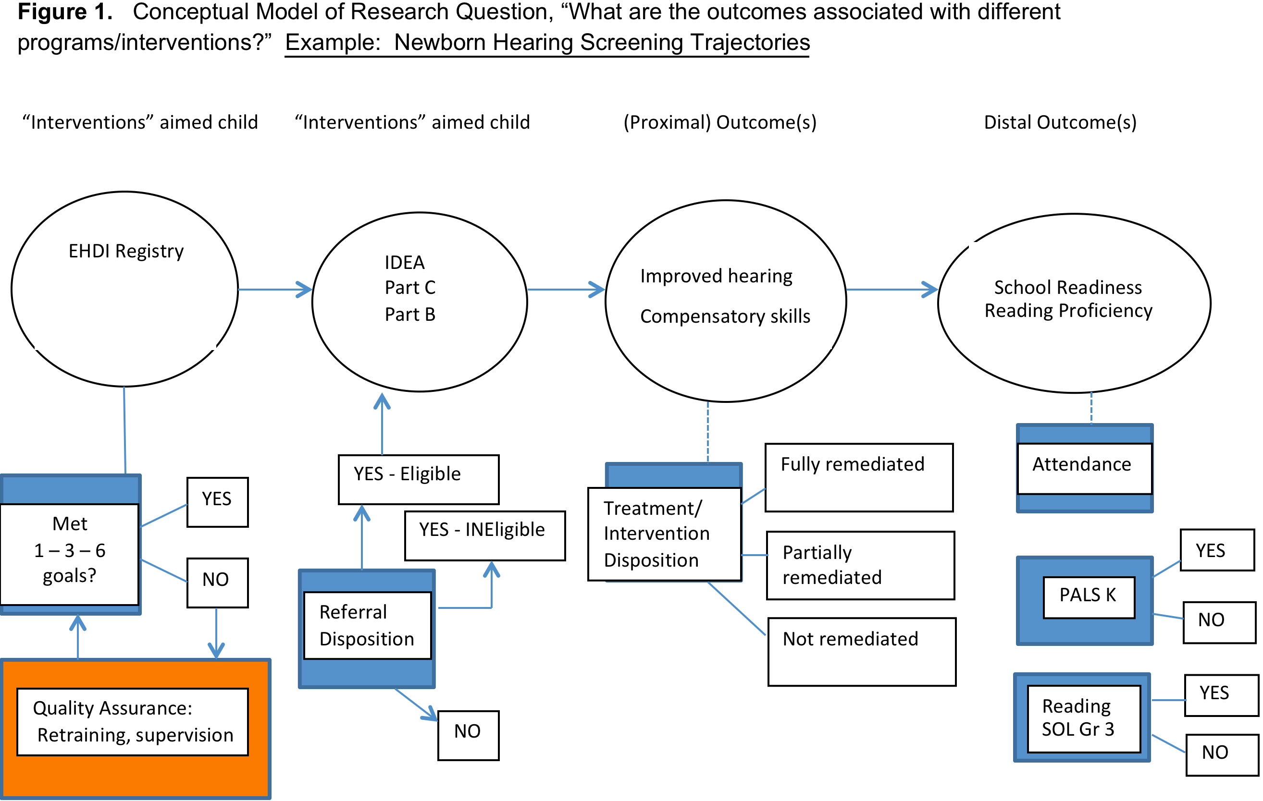

Slide 34
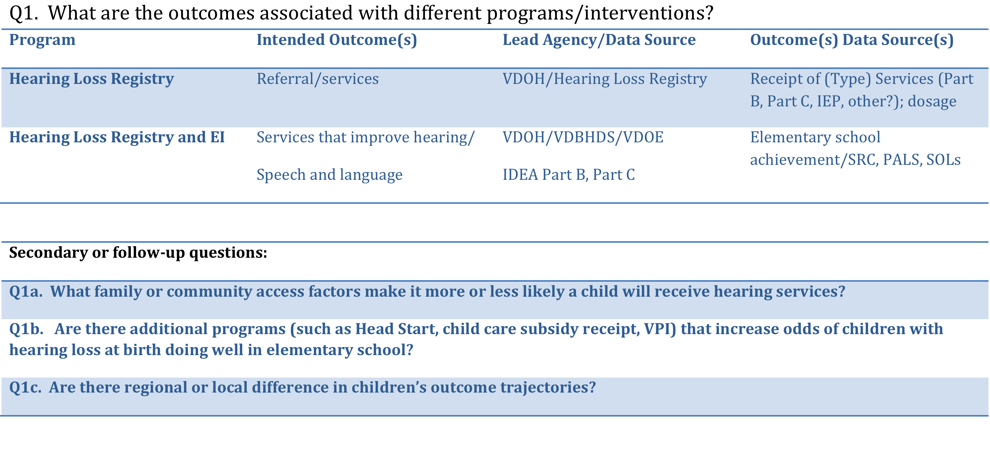
Databases, Systems Programs, and Data
Owners Needed to Address Questions

Slide 35
Bringing Service and Research Dollars
into Virginia
With proper infrastructure support, Project Child HANDS,
together with the VLDS, has the potential to bring active
foundation and other funding into the Commonwealth.
Example: Project LAUNCH (SAMHSA RFP SM-12-009)
Cooperative Agreements for Linking Actions for Unmet
Needs in Children’s Health
(Up to $850,000 per year, 5 years, no match)
Example: Managing and Learning from Activities in
Payment and Delivery System Reform
(Robert Wood Johnson Foundation)

Slide 36
Project Child HANDS Partners/Advisors
Virginia Department of Social Services
Barb Newlin, Kathy Gillikin, Zelda Boyd, Todd Areson (ret.), Erik Beecroft (until June, 2013)
Virginia Department of Education
Bethann Canada, Deborah Jonas (until June, 2012)
Thomas Santangelo
Virginia Early Childhood Foundation
Kathy Glazer, Angela Sullivan
Virginia Department of Health, Family Health Services
Dev Nair, Derek Chapman, Christopher Hill

Slide 37
www.childhands.org
Aaron Schroeder: aaron.schroeder@vt.edu (technology engineering)
Isabel Bradburn: isbrad@vt.edu
(research agenda and data governance)
VDH liaison Derek Chapman: derek.chapman@vdh.virginia.gov

Slide 38
THANK YOU!
We acknowledge and thank our funders, the Office of Planning, Research and Evaluation in the Administration for Children and Families; Virginia Departments of Social Services and of Education, and Virginia Tech. Thank you to our program officer Kathleen Dwyer and fellow state-research partners in Maine, Maryland, and South Carolina.
We also thank Wave I and II local departments of social services and school divisions for their input, feedback and data with which to develop and test Project Child HANDS.

Slide 39
Technical Details

Slide 40
Getting Data Ready for “De-Identified Federation”
What the Data Adapter Does
Name Cleaning
Name Encoding
DeSmithBarney
Substitution Alphabet – Dynamically Generated using Hashing Key (below)
De’Smith-Barney IV
De’Smith-Barney IV
YDXWKQTAGOLCNSVEFHMRJPBZUI
Remove Suffix
Substitution Cipher
De’Smith-Barney
CSXBWPAKNOQSH
De’Smith-Barney
Hashing Key – Dynamically Generated and sent from HANDS
Remove Symbols
Order Hashing
b164f11d-aa37-44ca-93c3-82d3e0155061
DeSmithBarney
C57S78XCEBF9WECP2AA9DK59N1CO27QBES54HFD
CLEANED & ENCODED for TRANSPORT
DeSmithBarney
C57S78XCEBF9WECP2AA9DK59N1CO27QBES54HFD

Slide 41
Cleaned and Encoded Matching Data (Internal ID, First and Last Name)
INTERNAL_ID_HASHED | FIRST_NAME | LAST_NAME
044AA90CE74E2ED3B6B0B0CFE93F8ED263B73050 | F11BDAE3EM86AE8 | J11EDAV3E
044AA90CE74E2ED3B6B0B0CFE93F8ED263B73050 | F11BDAE3EM86AE8 | J11EDAV3E
044AA90CE74E2ED3B6B0B0CFE93F8ED263B73050 | F11BDAE3EM86AE8 | J11EDAV3E
044AA90CE74E2ED3B6B0B0CFE93F8ED263B73050 | F11BDAE3EM86AE8 | J11EDAV3E
044AA90CE74E2ED3B6B0B0CFE93F8ED263B73050 | F11BDAE3EM86AE8 | J11EDAV3E
044AA90CE74E2ED3B6B0B0CFE93F8ED263B73050 | F11BDAE3EM86AE8 | J11EDAV3E
044AA90CE74E2ED3B6B0B0CFE93F8ED263B73050 | F11BDAE3EM86AE8 | J11EDAV3E
044AA90CE74E2ED3B6B0B0CFE93F8ED263B73050 | F11BDAE3EM86AE8 | X11SDAK3EF86
044AA90CE74E2ED3B6B0B0CFE93F8ED263B73050 | F11BDAE3EM86AE8 | X11SDAK3EF86
044AA90CE74E2ED3B6B0B0CFE93F8ED263B73050 | F11BDAE3EM86AE8 | X11SDAK3EF86
044AA90CE74E2ED3B6B0B0CFE93F8ED263B73050 | F11BDAE3EM86AE8 | J11EDAV3E
044AA90CE74E2ED3B6B0B0CFE93F8ED263B73050 | F11BDAE3EM86AE8 | J11EDAV3E
044AA90CE74E2ED3B6B0B0CFE93F8ED263B73050 | F11BDAE3EM86AE8 | J11EDAV3E
044AA90CE74E2ED3B6B0B0CFE93F8ED263B73050 | F11BDAE3EM86AE8 | J11EDAV3E
044AA90CE74E2ED3B6B0B0CFE93F8ED263B73050 | F11BDAE3EM86AE8 | J11EDAV3E
044AA90CE74E2ED3B6B0B0CFE93F8ED263B73050 | F11BDAE3EM86AE8 | X11SDAK3EF86
044AA90CE74E2ED3B6B0B0CFE93F8ED263B73050 | F11BDAE3EM86AE8 | X11SDAK3EF86
044AA90CE74E2ED3B6B0B0CFE93F8ED263B73050 | F11BDAE3EM86AE8 | J11EDAV3E
044AA90CE74E2ED3B6B0B0CFE93F8ED263B73050 | F11BDAE3EM86AE8 | J11EDAV3E
044AA90CE74E2ED3B6B0B0CFE93F8ED263B73050 | F11BDAE3EM86AE8 | J11EDAV3E
044AA90CE74E2ED3B6B0B0CFE93F8ED263B73050 | F11BDAE3EM86AE8 | J11EDAV3E
044AA90CE74E2ED3B6B0B0CFE93F8ED263B73050 | F11BDAE3EM86AE8 | J11EDAV3E
044AA90CE74E2ED3B6B0B0CFE93F8ED263B73050 | F11BDAE3EM86AE8 | J11EDAV3E
044AA90CE74E2ED3B6B0B0CFE93F8ED263B73050 | F11BDAE3EM86AE8 | J11EDAV3E
044AA90CE74E2ED3B6B0B0CFE93F8ED263B73050 | F11BDAE3EM86AE8 | J11EDAV3E
044AA90CE74E2ED3B6B0B0CFE93F8ED263B73050 | F11BDAE3EM86AE8 | J11EDAV3E
044AA90CE74E2ED3B6B0B0CFE93F8ED263B73050 | F11BDAE3EM86AE8 | J11EDAV3E
044AA90CE74E2ED3B6B0B0CFE93F8ED263B73050 | F11BDAE3EM86AE8 | J11EDAV3E
044AA90CE74E2ED3B6B0B0CFE93F8ED263B73050 | F11BDAE3EM86AE8 | X11SDAK3EF86
044AA90CE74E2ED3B6B0B0CFE93F8ED263B73050 | F11BDAE3EM86AE8 | X11SDAK3EF86
044AA90CE74E2ED3B6B0B0CFE93F8ED263B73050 | F11BDAE3EM86AE8 | J11EDAV3E
044AA90CE74E2ED3B6B0B0CFE93F8ED263B73050 | F11BDAE3EM86AE8 | J11EDAV3E
044AA90CE74E2ED3B6B0B0CFE93F8ED263B73050 | F11BDAE3EM86AE8 | J11EDAV3E
044AA90CE74E2ED3B6B0B0CFE93F8ED263B73050 | F11BDAE3EM86AE8 | J11EDAV3E
044AA90CE74E2ED3B6B0B0CFE93F8ED263B73050 | F11BDAE3EM86AE8 | J11EDAV3E
INTERNAL_ID is the same
LAST_NAME is NOT
Many agencies DO NOT have an Index of unique individuals. There can be many representations of that individual.
What do we do?
Statistical Log Analysis and Reduction
We dynamically build a new “virtual” record made up of “most likely” demographics

Slide 42
Probabilistic Linkage Process (Creating a Linking Directory)
(After we have a unique person index for each agency dataset)
Blocking
Matching a 10,000 record set against a 1,000,000 record set = 10 BILLION possible combinations to analyze!
It will take many hours/days
However, we know there can only be at most 10,000 -- Big waste of time and resources
Instead, we block, aka “pre-match”, on differing criteria, like last name, birth month, etc.. This usually cuts down possible combinations into the 10k-100k range – much better!
We block on many different criteria combinations in case one blocking scheme misses a match (e.g. because of misspellings)
The m probability (quality) -- if we have two records that we know match, then all of the paired field values should, in a perfect world, match. If some of the fields don’t match, then we have some degree of quality/reliability problem with those fields.
The u probability (commonness) -- if we have two records that we know don’t match, how likely is it that the values in a particular field pairing (e.g. “City”) will match anyway (because of the relative commonness of the values)?
Linkage Determination – A Cutoff score needs to be set for each blocked comparison, below which a link is not accepted as a real “link”
The best method of establishing this cutoff is for the system operator to work with a content-area expert to determine the peculiarities of data for that content-area
In some data sets in may be very unlikely that a birthdate was entered incorrectly, while in another, it may happen very regularly – a computer can not automatically know this
Once these cutoffs are set, they don’t need to be changed unless something drastic occurs to change the nature of the dataset
Matching, Weighting and Scoring
Weights for matches and non-matches are applied, and scores are summed
m and u Parameter Calculation
DS_1_UNQ_ID | DS_2_UNQ_ID | LN_MATCH | FN_MATCH | BD_MATCH | BM_MATCH | BY_MATCH | G_MATCH | F_MATCH | SCORE
4688B2133F14C8199823C840337215AB3D3B29E9 | 2E56D712A3D067F72AC8F55369955C07AD9883A7 | -0.32863 | -0.38268 | 4.860003 | 3.558016 | 3.111244 | 0 | 4.827663 | 15.64562
010CE606E5377BE06E5A8CAFB744469FC8AD294B | 2F71159DC11FF41501CA566BB09226FDA33176EF | -0.32863 | -0.38268 | 4.860003 | 3.558016 | 3.111244 | 0 | -2.63347 | 8.184482
23F83BEFE63B2CD834F9321CC101775CA45ADE68 | 0567FD2B0C73D17B0BF6557760B7D25A6C989C6B | -0.32863 | -0.38268 | 4.860003 | 3.558016 | 3.111244 | 0 | 4.827663 | 15.64562
89B297C9C6B6B0A08B624E93B66CA72A0D66FF2E | 15E8F1EF7836B73B217EF9D15F20A3571E033324 | 1.374464 | -0.38268 | 4.860003 | 3.558016 | 3.111244 | 0 | 4.827663 | 17.34871
020CE2F16598957659AE2A7D3B49D1638693422C | 1C42EB0E1FBA6D06F47C4A0D7D5EA6C89CC21B5B | 1.374464 | 2.083825 | 4.860003 | 3.558016 | 3.111244 | 0 | 4.827663 | 19.81521
86EE156D74C29DF4DDAC621F86CC9E0BC8CA0BD6 | 0DED671A93276C5BCEBC0BCBB915159320365B33 | -0.32863 | -0.38268 | 4.860003 | 3.558016 | 3.111244 | 0 | 4.827663 | 15.64562
DD3DFB0CDEDD9F076DCB613AC81BC0EB0A1266ED | 0D55B49A56B0F8FA9A9C5140400C564B4E2AB9E7 | 1.374464 | -0.38268 | 4.860003 | 3.558016 | 3.111244 | 0 | 4.827663 | 17.34871
Matching-Column Weight Calculations
Match Scoring
Linkage Determination
and addition to Linking Directory

